Slide 1

SHREE UTTAR GUJARAT BBA & BCA
COLLEGE
Semester – 5
Project submission for Sem – 5
HOTEL MANAGEMENT SYSTEM(COZYstay)
Student Name :
Jariwala Prachi R.
Student Exam No :
4329

Slide 2
INDEX
SR_NO. | CHAPTER
1 | Introduction
2 | Hardware and Software Requirements
3 | Technology Used
4 | Project Modules
5 | Advantages
6 | Scope and Objectives
7 | Data Dictionary
8 | Data Flow Diagram
9 | Output Design
10 | Drawbacks
11 | Conclusion
12 | References

Slide 3

INTRODUCTION
CozyStay is a comprehensive hotel management system designed to streamline operations and enhance guest experiences.
It facilitates online reservations, allowing guests to book, modify, or cancel their stays seamlessly.
The system maintains detailed guest profiles, capturing preferences and histories to provide personalized services.
User roles and permissions enhance data security, enabling staff to perform their tasks efficiently.

Slide 4
HARDWARE AND SOFTWARE
Hardware Requirements
Software Requirements
Processor | Intel Core i7
RAM | 8 GB
Hard Disk | 238 GB
Disk Space | 10 GB Minimum
Operating System | Microsoft Windows 10
Frontend | VsCode
Backend | Node JS
Scripting Language | JavaScript
DataBase | MongoDB

Slide 5
TECHNOLOGIES USED
Frontend : HTML , CSS , JavaScript , React.js, Bootstrap
Backend : Node.js
Database : MongoDB

Slide 6
PROJECT MODULE
USERS:
Users: Can visit the website and view the rooms.
Registration: Register module is for the user who visit to our website and enter their details for further login in. User must be registered in CozyStay Website when he/she wants to book their rooms.
Login: Login module is also for the user. He/she can only reach the website when it is logged in. User can only login after the registration is done.
Room Management: In this section, user can see different types of rooms and payment details also.
Logout: In this section, user can log out their profile.
ADMIN:
Rooms: In this section, Admin can add , delete and update the rooms.
Bookings: In this section, Admin can view and manage the customer bookings.
Users: In this section, Admin can view the details of users like userID, Name, Email and IsAdmin or Not.

Slide 7
ADVANTAGES
One of the primary benefits is the streamlining of operations; by automating key processes like bookings, billing, and room management, the system significantly reduces manual workloads and minimizes errors.
This efficiency extends to both staff and guests, thanks to an intuitive interface that enhances user experience.
Real-time updates are another crucial feature, allowing guests to access up-to-date room availability and make bookings instantly, thereby reducing the risk of overbookings.
Finally, CozyStay is designed to be cost-efficient.

Slide 8
SCOPE
The future scope for enhancing hotel management systems is promising.
Implement AI-driven features for personalized guest experiences, dynamic pricing, and predictive analytics.
Develop mobile apps for staff and guests, allowing for on-the-go management and booking.
Integrate features that help track and manage sustainability initiatives, such as energy consumption.
Provide more customizable reporting tools and dashboards for different stakeholders.

Slide 9
OBJECTIVES
Provide a user-friendly interface that allows guests to easily navigate the website, make bookings, and access information about the hotel.
Encourage guests to book directly through the website by offering competitive pricing and exclusive deals.
Providing various types of rooms such as delux, executive, suite.
User can easily book their orders by logging in or else they can easily cancel their booking.
Section for users to leave reviews and feedback.
Also providing navigation map for location.

Slide 10
DATA DICTIONARY
Table Name: - Users
FIELD_NAME | DATATYPE | SIZE | CONSTRAINTS
ID | Integer | 255 | Primary key
NAME | String | 255 | Not null
EMAIL | String | 255 | Not null
PASSWORD | Integer | 255 | Not null
IsAdmin | Boolean | - | Check

Slide 11
Table Name: - Rooms
FIELD_NAME | DATATYPE | SIZE | CONSTRAINTS
ID | String | 255 | Primary key
NAME | String | 255 | Not null
MAXCOUNT | Number | 250 | Not null
PHONE NUMBER | Number | 250 | Not null
RENT PER DAY | Number | 250 | Not null
IMGURLS[ ] | String | 255 | Not null
CURRENT BOOKING | Array | 255 | -
TYPE | String | 255 | Not null
DESCRIPTION | String | 255 | Not null

Slide 12
Table Name: - Bookings
FIELD_NAME | DATATYPE | SIZE | CONSTRAINTS
ID | String | 255 | Primary key
ROOM | String | 255 | Not null
ROOM ID | String | 255 | Not null
USERID | String | 255 | Not null
FROM DATE | String | 255 | Not null
TO DATE | String | 255 | Not null
TOTAL AMOUNT | Number | 255 | Not null
TOTAL DAYS | Number | 255 | Not null
TRANSACTION ID | String | 255 | Not null
STATUS | String | 255 | Not null

Slide 13
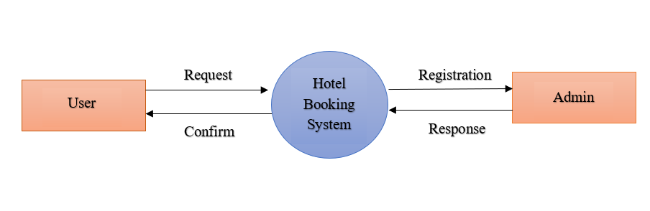
DATA FLOW DIAGRAM
0 level – Context level

Slide 14
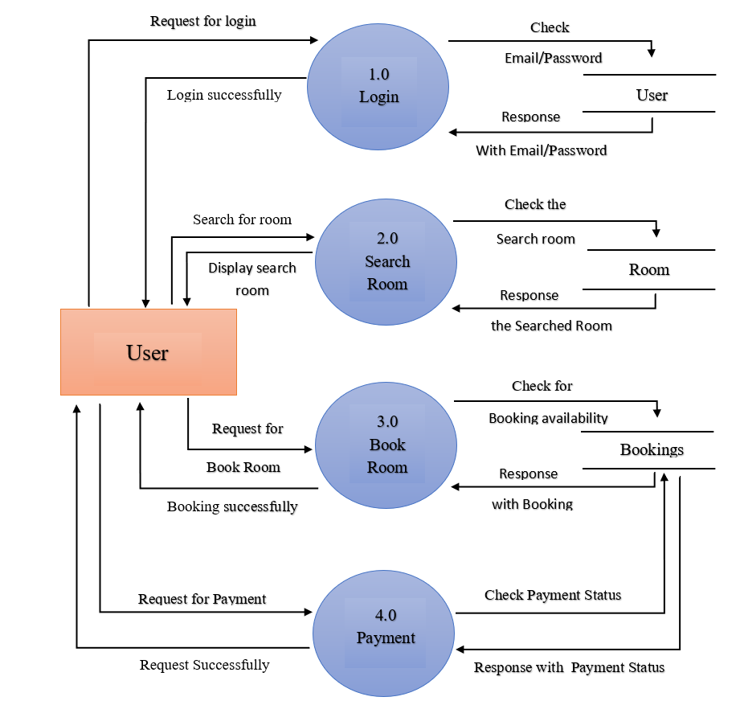
1 level – User

Slide 15
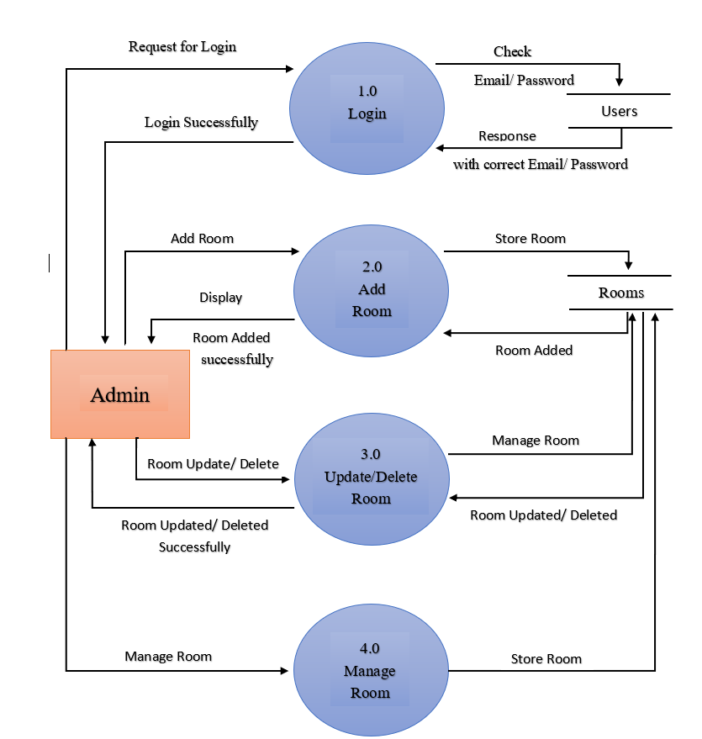
1 level – Admin

Slide 16
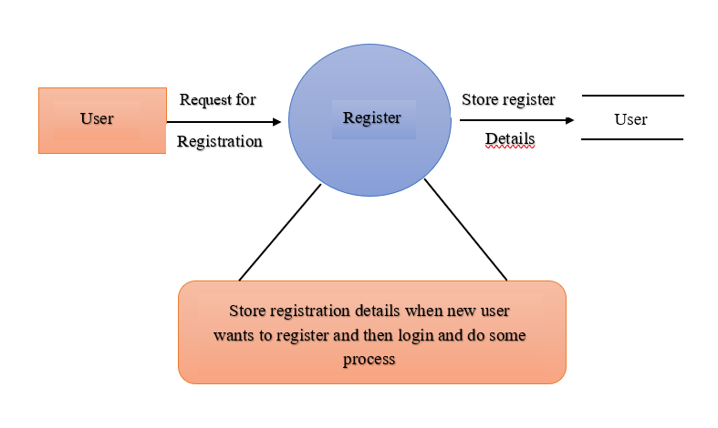
PROCESS SPECIFICATION
Register process

Slide 17
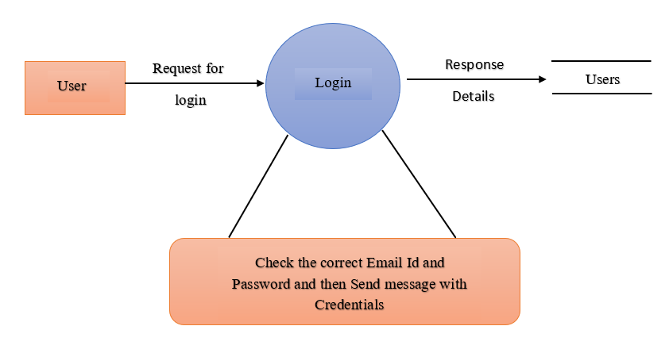
Login process

Slide 18
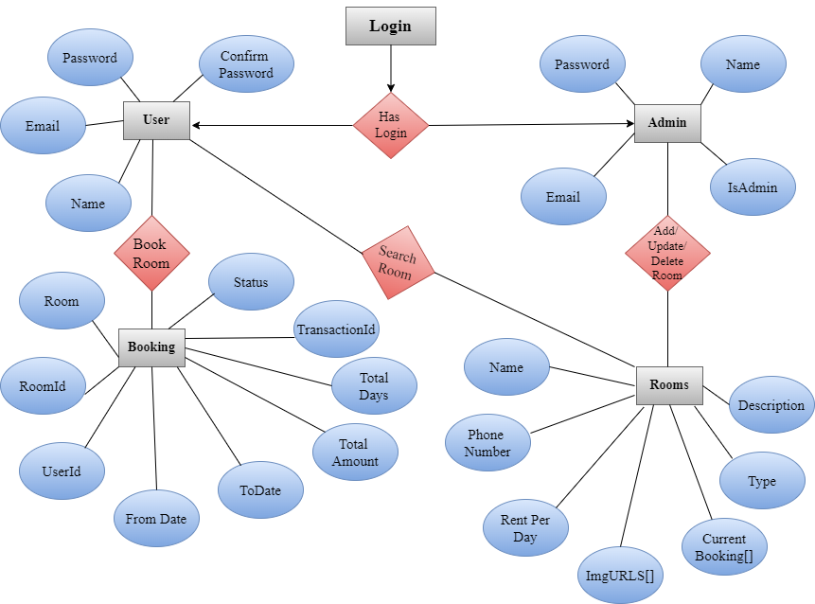
ENTITY-RELATIONSHIP DIAGRAM

Slide 19
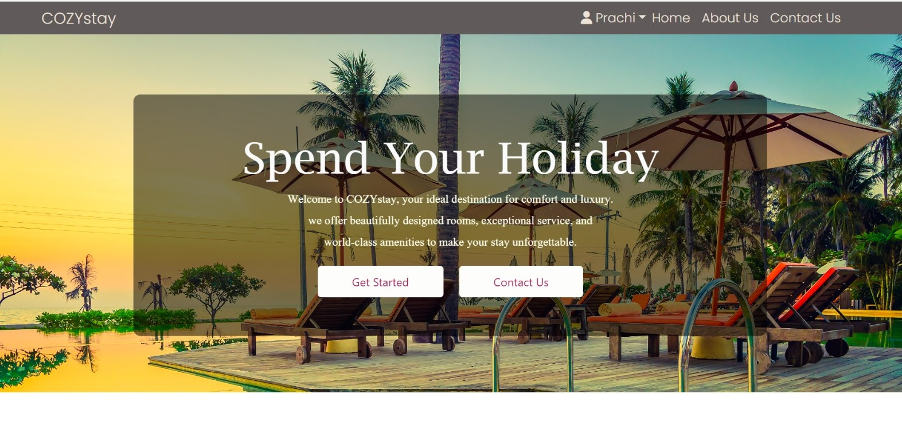
OUTPUT DESIGN
landingScreen.jsx

Slide 20
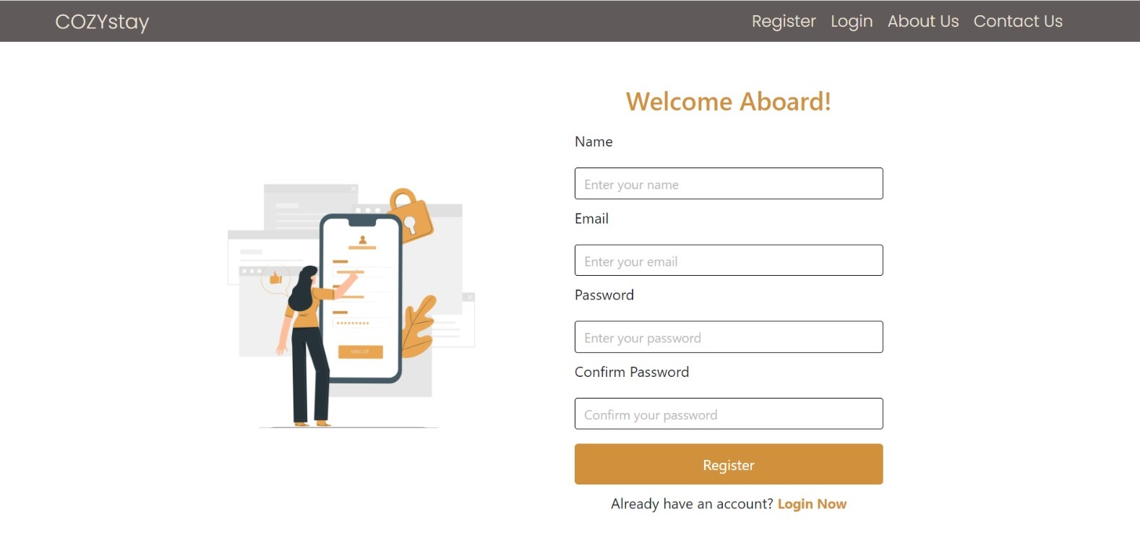
registerScreen.jsx

Slide 21
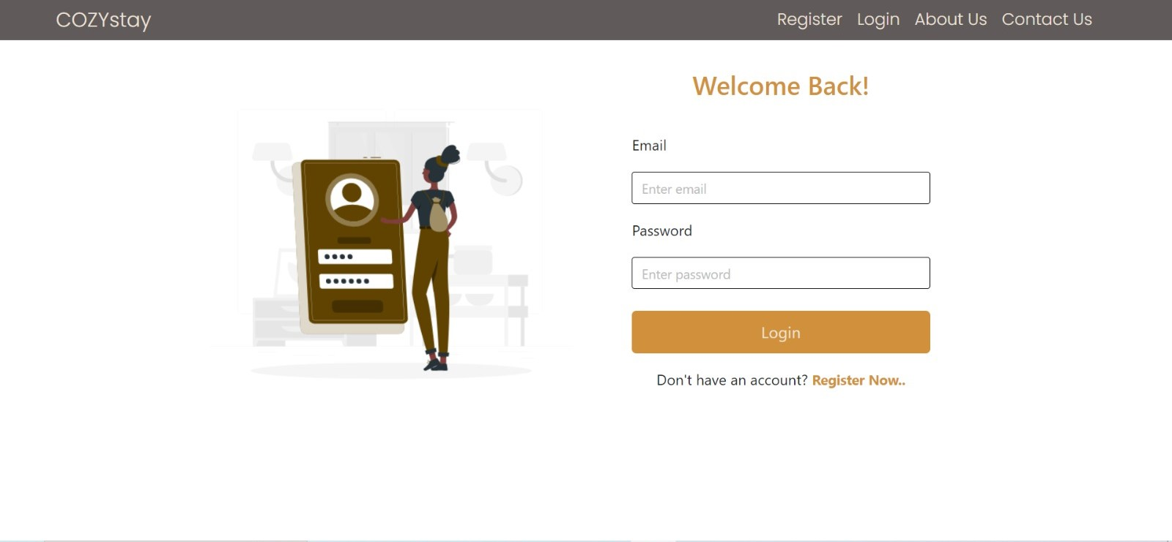
loginScreen.jsx

Slide 22
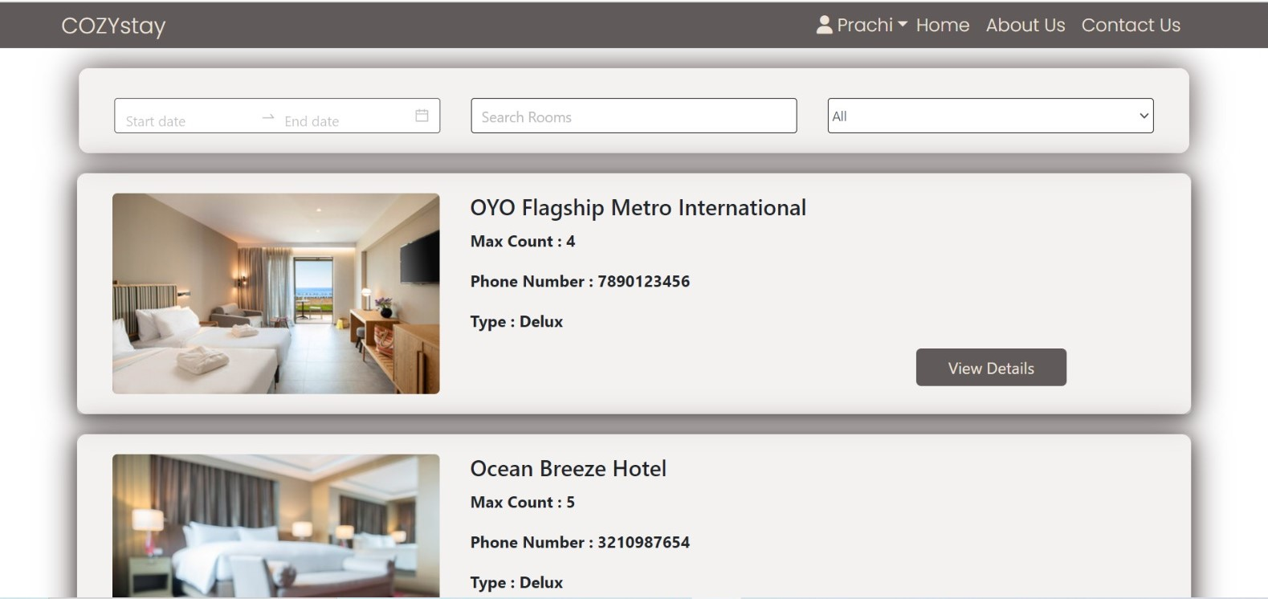
homeScreen.jsx

Slide 23
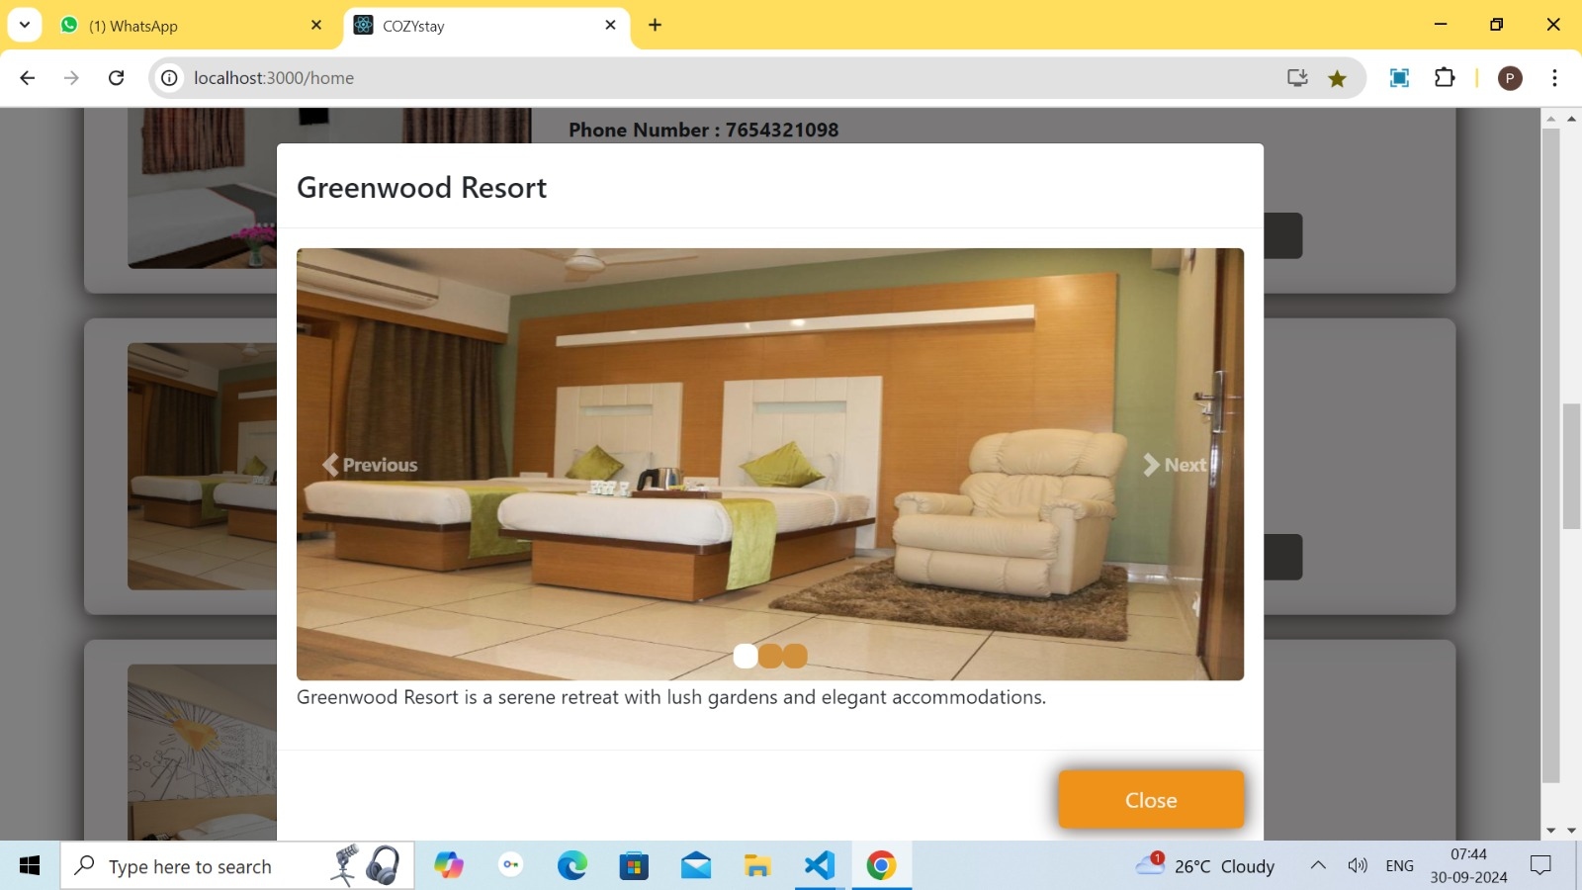
room.jsx

Slide 24
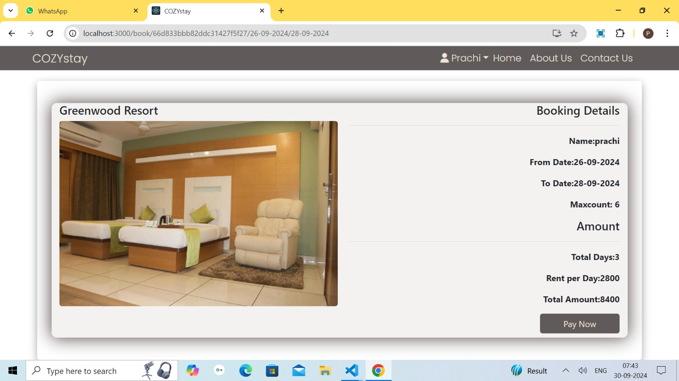
bookingScreen.jsx

Slide 25
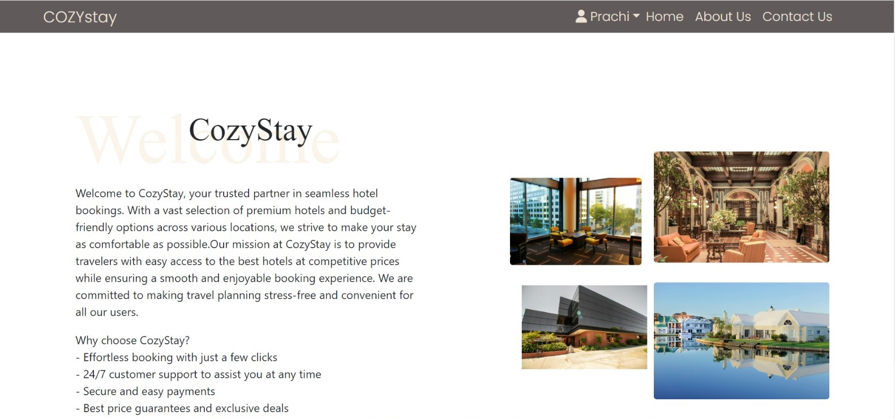
aboutUs.jsx

Slide 26
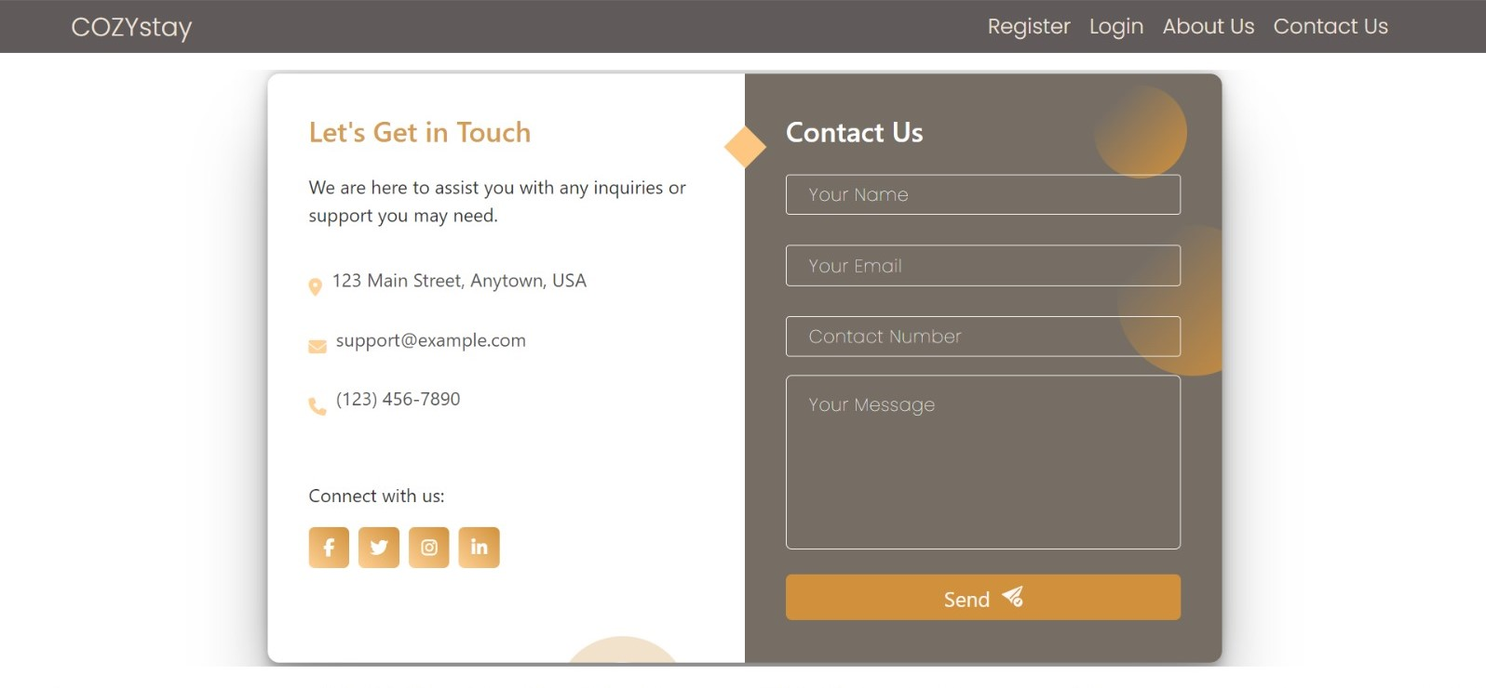
contactUs.jsx

Slide 27
DRAWBACKS
When user logged in he/she cannot able to modify the login details and has no permission to modify the room details.
Admin cannot change his/her profile.
Customizations options is not available.

Slide 28
CONCLUSIONS
The project titled as “COZYstay” hotel management was deeply studied and analyzed to design the code and implement. It was done under the guidance of the experienced project guide. All the current requirements and possibilities have been taken cared during the project time.
COZYstay management is a web-based application which secures and manages note information that are important to users.

Slide 29
REFERENCES
For React.js :
https://legacy.reactjs.org/
https://react.dev/
https://www.npmjs.com/package/react-router-dom
For Node.js :
https://nodejs.org/en
For MongoDB:
https://www.mongodb.com/
https://www.mongodb.com/products/tools/compass

Slide 30
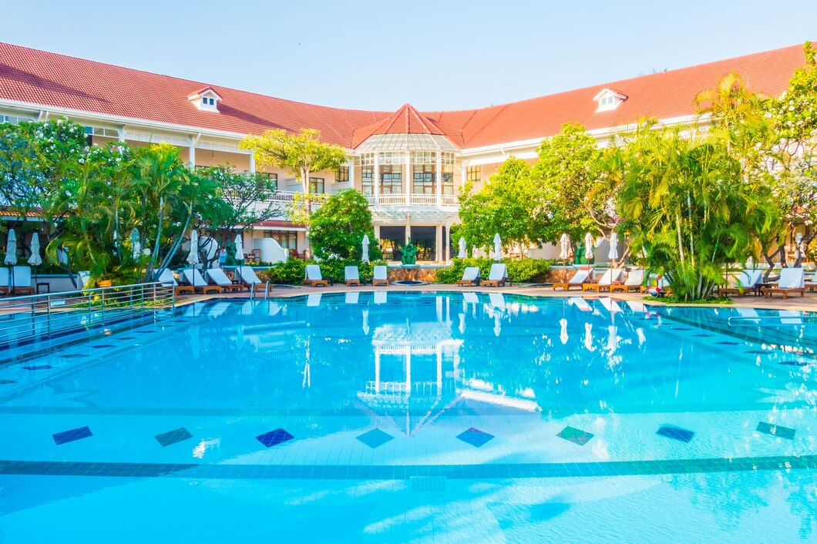
THANK
YOU

